Slide 1
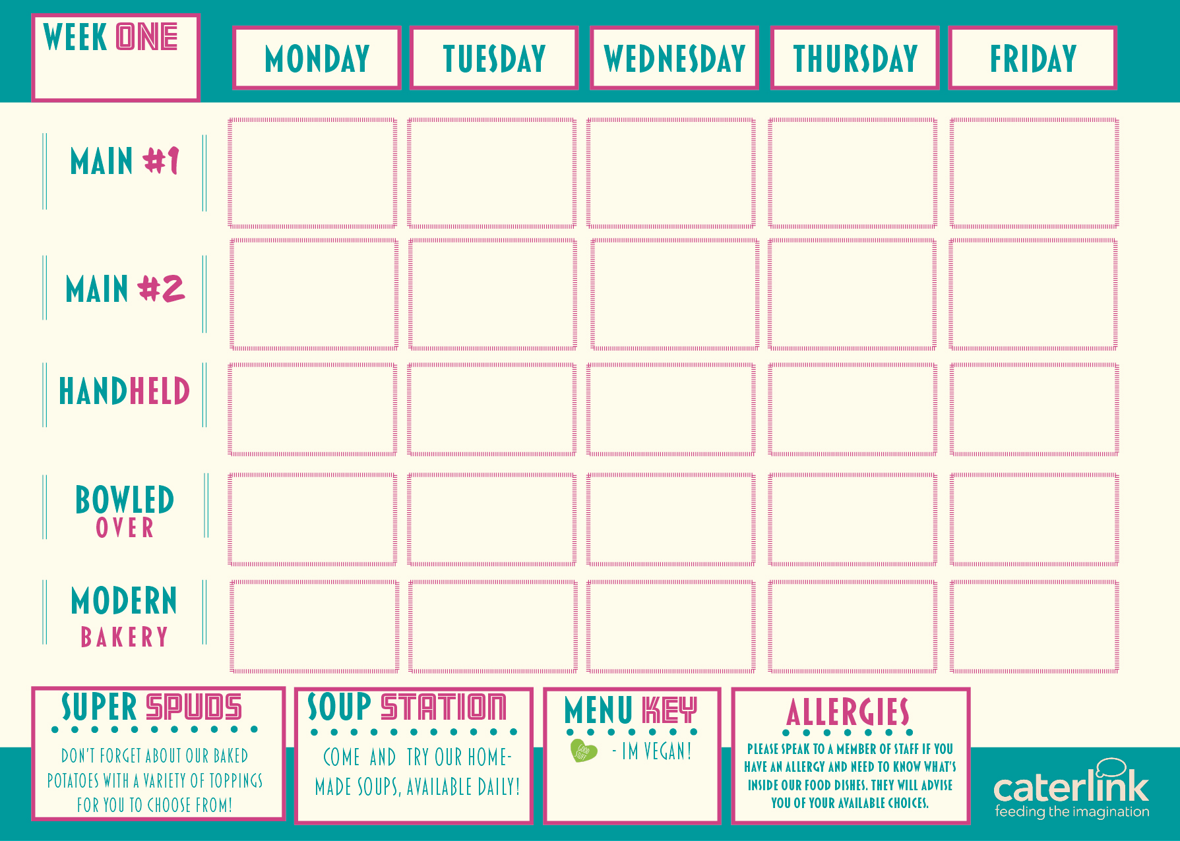
Macaroni Cheese with Roasted Veg or Crunchy Crouton Topping
Chicken Enchilada
With rice
Roast Chicken
New Potatoes, Seasonal veg & Gravy
Jerk Chicken
with Rice & peas
& pineapple slaw
Sausages served with Chips, Mushy Peas & Curry Sauce
Quorn Chilli with
Loaded Wedges
Roasted Vegetable
Filo Pastry Tart with New Potatoes
& Seasonal Veg
Curried Squash, Sweet Potato & Butterbean, Stew
With Rice, Peas & Pineapple Slaw
Vegan Sausages with Chips &Mushy Peas
& Curry Sauce
Bang Bang cauliflower Bread & Salad
Spud Station
Cheese Coleslaw Beans or Tuna
Cheese Coleslaw Beans or Tuna
Cheese Coleslaw Beans or Tuna
Cheese Coleslaw Beans or Tuna
Cheese Coleslaw Beans or Tuna
Cold Meal Deal
Filled Baguette,
Drink and Dessert
Filled Baguette,
Drink and Dessert
Filled Baguette,
Drink and Dessert
Filled Baguette,
Drink and Dessert
Filled Baguette,
Drink and Dessert
A Selection of Desserts
A Selection of Desserts
A Selection of Desserts
A Selection of Desserts
A Selection of Desserts

Slide 2
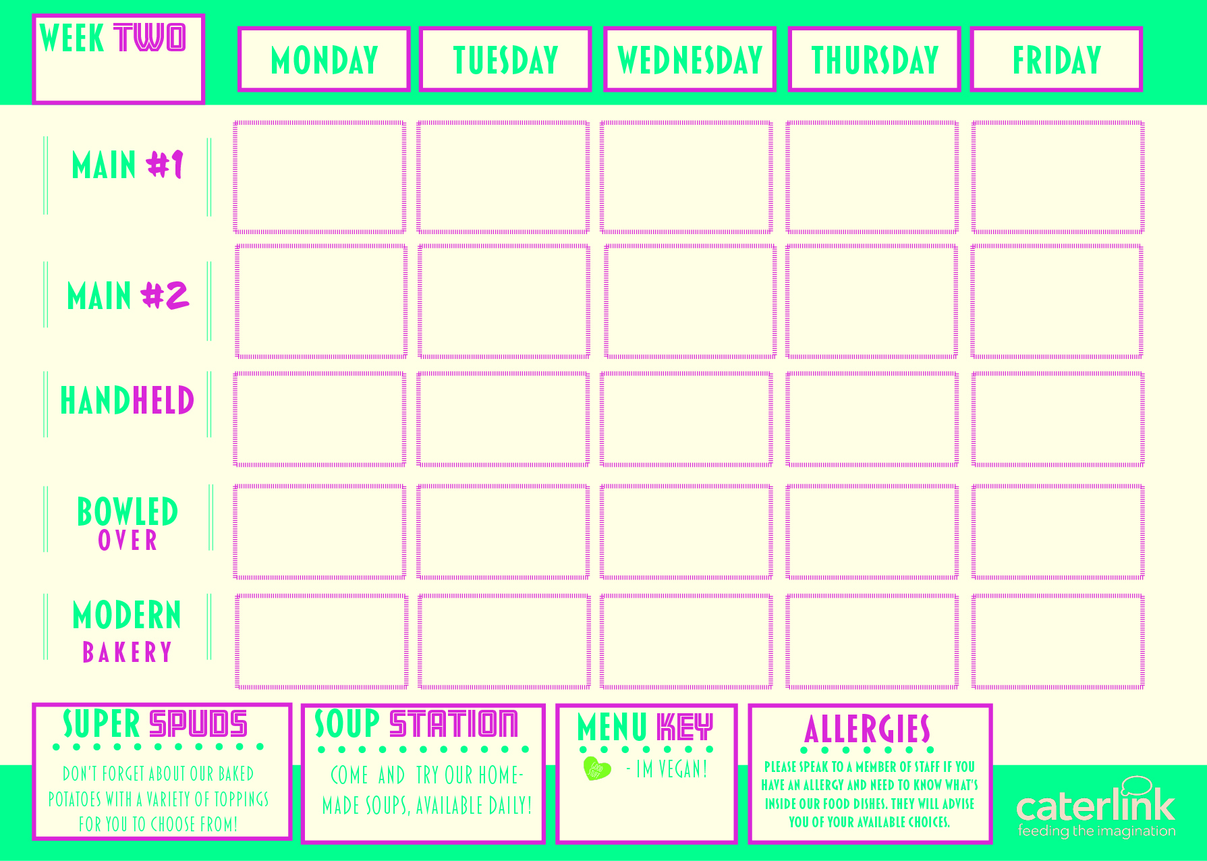
Sausage & Red Onion
Chutney Hot Baguette
With Roasted
New Potatoes
Vegetable Chow Mein
Chicken Souvlaki
With Greek Salads
Chicken Tikka Masala served with Rice
Fish
with Chips & Peas
Sweet & Sour
Vegetables
With
Rice
Vegan Sausage & Red Onion Chutney Hot Baguette with Roasted New Potatoes
Sweet Potato, Chickpea
& Spinach Curry
With Rice
Vegan Sausage Roll
With chips & peas
Butternut Squash & Spinach Parcel with
Greek Salads
Spud Station
Cheese Coleslaw Beans or Tuna
Cheese Coleslaw Beans or Tuna
Cheese Coleslaw Beans or Tuna
Cheese Coleslaw Beans or Tuna
Cheese Coleslaw Beans or Tuna
Cold Meal Deal
Filled Baguette,
Drink and Dessert
Filled Baguette,
Drink and Dessert
Filled Baguette,
Drink and Dessert
Filled Baguette,
Drink and Dessert
Filled Baguette,
Drink and Dessert
Selection of Desserts
Selection of Desserts
Selection of Desserts
Selection of Desserts
Selection of Desserts

Slide 3
Vegetarian Toad in the Hole with Mashed
Potatoes & Gravy
Beef Lasagne
With
Garlic Bread & Salads
Fish & Chips,
With Baked Beans,
Spicy Mexican Chicken & Rice
& sides
Chicken Paella with Patatas Bravas &
Salads
Crunchy Topped Tomato
Pasta Bake
With Roasted Veg
Vegetable Ragu
With
Garlic Bread & Salads
Vegetable Burger with
Chips & Baked Beans
Vegan Chilli with Rice
& Sides
Vegetable Paella with Patatas Bravas & Salads
Spud Station
Cheese Coleslaw Beans or Tuna
Cheese Coleslaw Beans or Tuna
Cheese Coleslaw Beans or Tuna
Cheese Coleslaw Beans or Tuna
Cheese Coleslaw Beans or Tuna
Cold Meal Deal
Filled Baguette,
Drink and Dessert
Filled Baguette,
Drink and Dessert
Filled Baguette,
Drink and Dessert
Filled Baguette,
Drink and Dessert
Filled Baguette,
Drink and Dessert
Selection of Desserts
Selection of Desserts
Selection of Desserts
Selection of Desserts
Selection of Desserts

