Slide 1
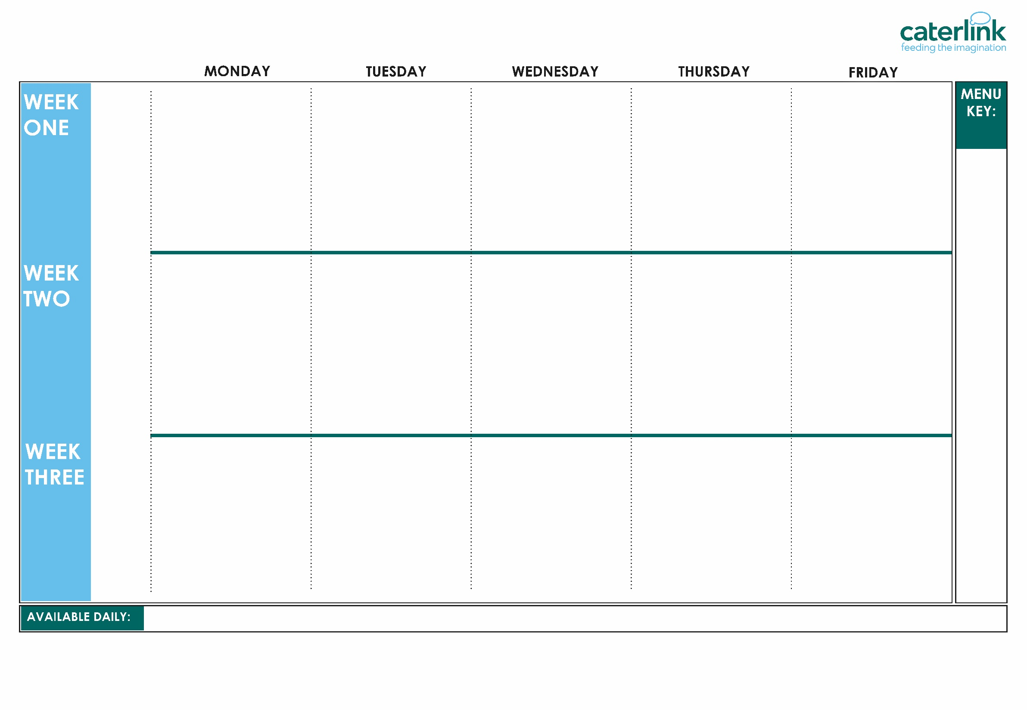






Churchill Menu 2026
Macaroni Cheese | Phat Pasty Pork Sausage Roll with Potato Wedges | Roast Chicken, Stuffing, Roast Potatoes & Gravy | Chicken Curry with Rice | Battered Fish with Chips & Tomato Sauce
Chickpea Curry with Rice | Mexican Bean Roll with Potato Wedges | Roasted Quorn, Roast Potatoes, & Gravy | Vegetable Curry with Rice | Vegan Sausage with Chips & Tomato Sauce
Vegetables of the Day | Vegetables of the Day | Vegetables of the Day | Vegetables of the Day | Vegetables of the Day
NEW Banana Mousse | Orange Drizzle Cake | Fresh Fruit | Apple Flapjack | Strawberry Jelly with Mandarins
Option
One
Option
Two
Sides
Dessert
13/04/26
04/05/26
01/06/26
22/06/26
13/07/26
31/08/26
21/09/26
12/10/26
Whole
grain
Cheese & Tomato Pizza with wedges | Beef Chilli with Rice | Roasted Pork Sausage, Roast Potatoes & Gravy | Chicken Curry with Rice | Pork Sausage with Chips & Tomato Sauce
Lentil & Sweet Potato Curry with Rice | Spaghetti & Plant balls in a Tomato Sauce | Vegan Sausage, Roast Potatoes & Gravy | Vegetable Curry with Rice | Vegan Sausage with Chips & Tomato Sauce
Vegetables of the Day | Vegetables of the Day | Vegetables of the Day | Vegetables of the Day | Vegetables of the Day
Iced Vanilla Sponge | Peaches & Ice Cream | Fresh Fruit | Jam & Coconut Sponge & Custard | Oaty Cookie
Option
One
Option
Two
Sides
Dessert
Plant
based
20/04/26
11/05/26
08/06/26
29/06/26
07/09/26
28/09/26
19/10/26
Added plant protein
Option
One
Option
Two
Sides
Dessert
Tomato Pasta | Beef Burger with Potato Wedges | Roast of the Day, Mashed Potatoes & Gravy | Chicken Curry with Rice | Breaded Chicken with Chips & Tomato Sauce
NEW Chinese Vegetable Noodles | Plant Burger with Potato Wedges | Vegetable Loaf with Stuffing, Mashed Potatoes & Gravy | Vegetable Curry with Rice | Vegan Sausage with Chips & Tomato Sauce
Vegetables of the Day | Vegetables of the Day | Vegetables of the Day | Vegetables of the Day | Vegetables of the Day
School Cake | Cheese & Crackers | Fresh Fruit | Apple Crumble with Custard | Vanilla Shortbread
27/04/26
18/05/26
15/06/26
06/07/26
14/09/26
05/10/26
Chef’s Special
Lower Carbon Footprint
Jacket Potatoes & Baguettes with a choice of fillings, Salad Bar, Fresh Fruit
If you would like to know about particular allergens in foods, please ask a member of the catering team for information. If your child has a school lunch and has a food allergy or intolerance you will be asked to complete a form to ensure we have the necessary information to cater for your child. We use a large variety of ingredients in the preparation of our meals and due to the nature of our kitchens it is not possible to completely remove the risk of allergen cross contact.

