Slide 1

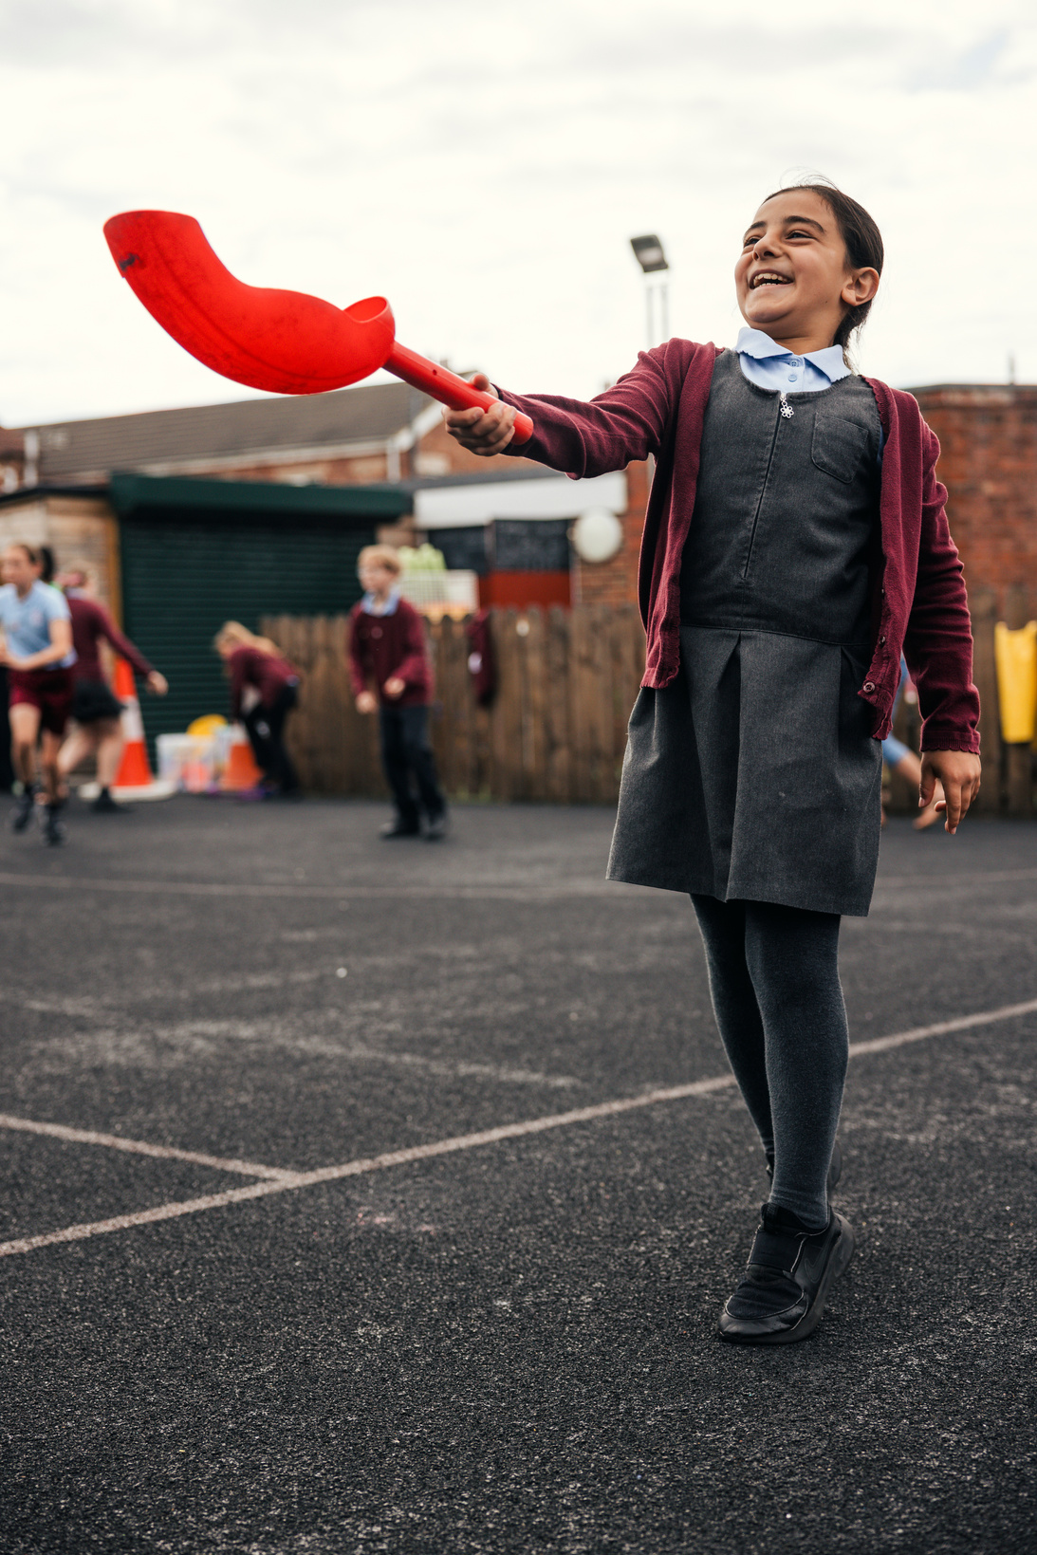

Part A
PE and Sport Premium transition toolkit
Monitoring form
2026/27 academic year

Slide 2
Part A PE and sport premium transition toolkit
Monitoring form
It is intended that this monitoring form should be used as preparation for the completion of the statutory DfE PE and sport premium digital expenditure reporting return. You can upload data (including swimming) from this template onto this platform once it becomes accessible.
The template is a working document that you can amend and up during the year.
Before you decide how you are going to use the funding for this academic year you should reflect and evaluate the impact of your use of your PE and sport premium funding in 2026/27.
You should use your evaluation of last year’s funding to help you decide what to do this academic year, how you will do it, and what impact you expect it to have.
All spending of the funding must conform with the terms outlined in the conditions of grant
The summative digital expenditure reporting form includes swimming and water safety information. PE and sport premium funding can be used to provide top-up lessons following the completion of core-swimming lessons where necessary, to ensure pupils meet national curriculum swimming requirements
To ensure funding is used effectively and based on your school’s needs; guidance and examples of best practice across schools can be found here.
You must use the funding to make additional and sustainable improvements to the PE and sport in your school.
You must develop and add to the PESSPA activities that your school already offers.
Useful Links:
PE and sport premium for primary schools - GOV.UK
PE and sport premium: conditions of grant 2026 to 2027 - GOV.UK
The grant also supports the Inclusion 2024 Inclusive PE hub an online platform of resources to help schools make PE and sport more inclusive.
Swimming and Water Safety

Slide 3
Review of the last academic year (2025/2026)
Take some time to reflect on your intent, implementation and impact from last academic year to celebrate your wins but to also think about improvements for the year ahead.
You do not need to complete every box. Just record the information that is key to your school's priorities and areas of focus.
Remember - Be clear about how you focused spending on key groups such as SEND, girls and disadvantaged pupils.
Swimming and Water Safety | What went well? Supporting evidence? | What didn't go well? Supporting evidence?
1. Swim competently, confidently and proficiently over a distance of at least 25 metres | 71% of pupils in year 6 can swim 25 metres. Evidenced through weekly swimming lessons based on information and data collected poolside with swimming teacher. | All students had made exceptional progress from their starting points. Students completed all areas of the curriculum, including life saving.
2. Use a range of strokes effectively (for example, front crawl, backstroke and breaststroke) | 71% of pupils in year 6 can use a range of strokes effectively. Evidenced through weekly swimming lessons based on information and data collected poolside with swimming teacher. . | All students had made exceptional progress from their starting points. All students built their water confidence from their starting point.
3. Perform safe self-rescue in different water-based situations | 71% of pupils in year 6 can perform safe self-rescue. Evidenced through weekly swimming lessons based on information and data collected poolside with swimming teacher. | All students had made exceptional progress from their starting points. All students built their water confidence from their starting point, this included wearing clothing in the pool and completing self-rescue.

Slide 4
Review of the last academic year (2025/2026)
Key areas as outlined in PE and sport premium guidance | What went well? Supporting evidence? | What didn't go well? Supporting evidence?
1. Increase all staff’s confidence, knowledge and skills in teaching PE and sporting activities | Change in curriculum due to reflections from the previous year. KS2 and KS3 PE is now a balance of curriculum objectives and wellbeing/physical fitness. Developing links within the local community to raise the profile of accessible sport. Establishing competitive and non-competitive pathway eg Unity Trust PowerHouseGames, establishing a SEN association football league. Teachers delivering PE have an understanding of the importance of being physically active. | Increase the support and enthusiasm from support staff within PE lessons. To enhance the resources and equipment so that teachers can confidently teach and to reduce an ineffective use of time.
2. Increase all pupils’ engagement in regular physical activity and sporting activities | Additional opportunities for all pupils to engage in physical activity at lunchtime and breaktime. Development of community engagement eg Haverhill Tennis Club, AbbeyCroft Leisure Centre. Inclusion of physical and sporting activities within the personal development curriculum. Developing an understanding of the difference between physical activity and sporting activities. Every class will take part in a ‘sport’ strand of personal development over the course of an academic year. | Not all pupils are active for 60 minutes a day, 7 days a week. Some students have a long journey to and from school, this creates time restrictions to be physical active.

Slide 5
Review of the last academic year (2025/2026)
Key areas as outlined in PE and sport premium guidance | What went well? Supporting evidence? | What didn't go well? Supporting evidence?
3. Raising the profile of PE and sport across the school, to support whole school improvement | Enhanced the number of opportunities available for both competitive and non-competitive opportunities. Created targeted events for those students that do no meet the active criteria Established links with Active Suffolk and enrolled to Active Suffolk Heathy Eating Award. Continued development of school football team. Increased the amount of outdoor learning. | Not all pupils are active for 60 minutes a day, 7 days a week. Some students have a long journey to and from school, this creates time restrictions to be physical active.
4. Offer a broader and more equal experience of a range of sports and physical activities to all pupils and ensure equal access to sport for boys and girls | Continuing to offer a wider range of activities both within and outside the curriculum (personal development) to get more pupils involved: Active personal development curriculum that doesn’t link to sport eg car washing, walking to the local park. Additional tailored opportunities on offer – curriculum time to engage all pupils – Airhop, climbing etc. Curriculum is adapted to suit each students interests to ensure they are physically active and not put off by the competitive nature of some traditional sports. | Not all pupils are active for 60 minutes a day, 7 days a week. Some students have a long journey to and from school, this creates time restrictions to be physical active.
5. Increase participation in competitive sport | Established a traditional sports day and inclusive sports day. Engaged with School Games Organiser to attend local events. Cross country, football and inclusive competitions. | Continue to develop our competition provision and balance this with inclusive activities.

Slide 6
What are your next steps for this 2026/27 academic year?
Aim | Why? | Key Area | Supporting evidence
To implement the Active Suffolk Healthy Schools Award. | Whole school and community impact. They have a secure understanding of school's priorities and supports the school to create an action plan for these. | Key indicator 1: Increase all staff’s confidence, knowledge and skills in teaching PE and sporting activities | Active Suffolk Healthy School Award action plan Termly meetings with Active Suffolk to discuss implementation and reflections.
Provide in school opportunities for pupils to access multiple opportunities to be physically active and monitor external physical activity to drive physical activity levels with key focus groups. | To aim for 100% of pupils will be active on average 60 minutes a day, 7 days a week. | Key Indicator 2: Increasing engagement of all pupils in regular physical activity and sporting activities | External physical activity trackers outlining the amount of activity pupils' access outside of school. Extra curricular timetable and participation data.
Provide regular intra school competition, as well as all pupils accessing inter competitions against other schools. Competition formats to reflect needs of pupils. Engage with school games offer. | To aim for 100% of pupils accessing competition in school, relevant to their needs, and outside of school, to encourage all pupils to participate and enjoy these valuable experiences. | Key indicator 5: Increasing participation in competitive sport | Competition formats and planning for all intra lesson level competitions, all inter competitions hosted at our school and sports day. Competition calendar and register of participants. Log of experiences kept Attend School Games competitions
Focus on top-up swimming and water safety for those pupils not achieving the expected swimming and water safety attainment. | To aim for 100% of pupils meet the expected swimming targets. | Key Indicators 1, 3, 4. Developing pupil attainment. | Evidenced on Swimming assessment tracker based on information and data collected poolside with swimming teacher.

Slide 7
PE and school sport checklist
Consider within your school where you currently stand and what further support you need to put in place.
Questions | Yes | Partly | No
Do you have a clear PE and school sport action plan for the year ahead (2026/27), agreed by leadership? | X
Can you evidence how last year’s PE and sport premium funding was spent, and what difference it made? | X
Do you know what Physical Education looks and feels like in your school and is this delivery high-quality? | X
Is there a clear plan to develop staff confidence in PE, whether delivery is internal, external or mixed? | X
Do you have a curriculum that is broad, progressive and properly sequenced across year groups? | X
Do you know how many pupils are active for at least 60 minutes a day, 7 days a week? |  | X
Do you have a clear plan for your extra-curricular club offer? | X
Is your wider school sport offer, including competitions, festivals, and fixtures planned? | X
Do you have effective data collection systems in place to record and evidence that swimming and water safety provision is on track to meet national curriculum requirements ? | X
Do you have a clear plan for encouraging SEND pupils and less active pupils to become more active and participate in PE and school sport? | X
If a governor, trust lead or external reviewer asked to see your PE and sport plan for future development, would you have clear evidence and rationale for impact? | X
Are you clear on existing links with local clubs, and community settings to identify where further support and engagement could be made using local support for enhance your provision? | X

Slide 8
Aims for the next academic year (2026/2027)
Using your whole school priorities, school development plan and previous PE, school sport and physical activity data, set out your aims for the year ahead.
Think about specific areas of need such as inactive girls, SEND and disadvantaged pupils
Remember to also input your swimming data and reflections in the table located at the bottom of this page.
Consider which of the 5 key areas improvements will be focusing on:
increase all staff’s confidence, knowledge and skills in teaching PE and sporting activities
increase all pupils’ engagement in regular physical activity and sporting activities
raise the profile of PE and sport across the school, to support whole school improvement
offer a broader and more equal experience of a range of sports and physical activities to all pupils, and ensure equal access to sport for boys and girls
increase participation in competitive sport
Please aim to use this as a live working document through the year.
Keep returning to this to evidence adaptations and progress made through the PESSPA opportunities you provide.
There is no set number of objectives you must have.
Make as many or as few as you see fit that will support your aims for the year ahead

Slide 9
Plan, monitor and evaluate (2026/2027)
Swimming and water safety
Questions | Yes | Partly | No
Do you have effective data collection systems in place to record and evidence that swimming and water safety provision is on track to meet national curriculum requirements ? | X
Will any of your year 6 group be accessing top up swimming to enable them to achieve the outcomes below? |  | X
Look at the attainment of your current year 6 cohort. Complete by July 31, 2027.
Swimming and Water Safety | What went well? Supporting evidence? | What didn't go well? Supporting evidence?
1. Swim competently, confidently and proficiently over a distance of at least 25 metres
2. Use a range of strokes effectively (for example, front crawl, backstroke and breaststroke)
3. Perform safe self-rescue in different water-based situations

Slide 10
Plan, monitor and evaluate (2026/2027)
Provide CPD and support to all staff
 | Intent - what is your objective? | Implementation - How will you achieve this? | Impact - What do you hope to see? | Supporting evidence
Plan and monitor (Complete now and monitor) | Focus on support staff training ensuring all teachers are confident to direct staff and enjoy teaching high-quality Physical Education. | Staff to model the importance of being physically active to students. Ensure scheme of work annual membership is paid to ensure teachers can access High-Quality planning and supporting resources. PE resources updated to enable High-Quality teaching to take place. | Staff's confidence and enthusiasm towards PE to increase . We predict that by July 2027, staff will feel confident in teaching or supporting the PE curriculum. By July 2027, we aim for all students' pupil voice to be fun and that they enjoy being physically active. | Staff confidence surveys, pupils' attainment data, lesson observation reviews, pupil voice.
 | What impact have you seen? | Are the improvements sustainable? How? | Supporting evidence | Approx. cost
Evaluate (to be completed by July 2027)

Slide 11
Plan, monitor and evaluate (2026/2027)
Drive physical activity levels
 | Intent - what is your objective? | Implementation - How will you achieve this? | Impact - What do you hope to see? | Supporting evidence
Plan and monitor (Complete now and monitor) | Provide in school opportunities for pupils to access multiple opportunities to be physically active and monitor external physical activity to drive physical activity levels with key focus groups. Therefore, aim for all pupils will be active on average 60 minutes a day, 7 days a week. | Increase the number and range of activities and clubs on offer (Pupil Led Games, dodgeball, games, dance. Parent and child fitness club.) Implementation of new extra-curricular timetable (personal development) Develop provision for physical activity at lunchtime by; Increasing the amount of playground resources to provide playground activity facilitated by lunchtime supervisors. Equipment and resources to be purchased for facilitation of activity with playleaders and independent active play. Use leadership ideas from scheme of work. | By July 2027 through the addition of new lunch and extra curricular opportunities, all students to know the importance of being physical active. Aim for teachers to think outside the box with their teaching and to deliver outdoor or active lessons, where possible, in any curriculum lesson. | External physical activity trackers outlining the amount of activity pupils’ access outside of school. Extra curricular timetable and participation data. Pupil voice.
 | What impact have you seen? | Are the improvements sustainable? | Supporting evidence | Approx. cost
Evaluate (to be completed by July 2027)

Slide 12
Plan, monitor and evaluate (2026/2027)
Develop competition
 | Intent - what is your objective? | Implementation - How will you achieve this? | Impact - What do you hope to see? | Supporting evidence
Plan and monitor (Complete now and monitor) | Ensure all pupils can access competition in school through regular intra school competition, as well as all pupils accessing inter-school competitions against other schools. Competition formats to reflect needs of pupils. Engage with school games offer. | Attend SGO events with other local primary schools. To attend belong activities (SGO) Competitions to be targeted and heavily supported due to the needs of the schools' learners. Arrange all UKS2 to represent school, on a least one occasion, through school games competitions and competition. | All KS2 students to attend a competition organized by the SGO. All students to take part in an inclusive sports day. All students to attend a traditional sports day. | Competition formats and planning for all intra-school lesson level competitions, all inter competitions hosted by the SGO. Virtual multi skills league format and results. Competition calendar and register of participants.
 | What impact have you seen? | Are the improvements sustainable? How? | Supporting evidence | Approx. cost
Evaluate (to be completed by July 2027)

